Slide 1

University College Cork
Generating Images Using a Deep Convolutional GANs
Kai

Slide 2

01
Introduction
02
Historical Models
Overview
03
Theoretical Background
04
Results
05
Discussion

Slide 3
University College Cork
1 Introduction
Kai

Slide 4
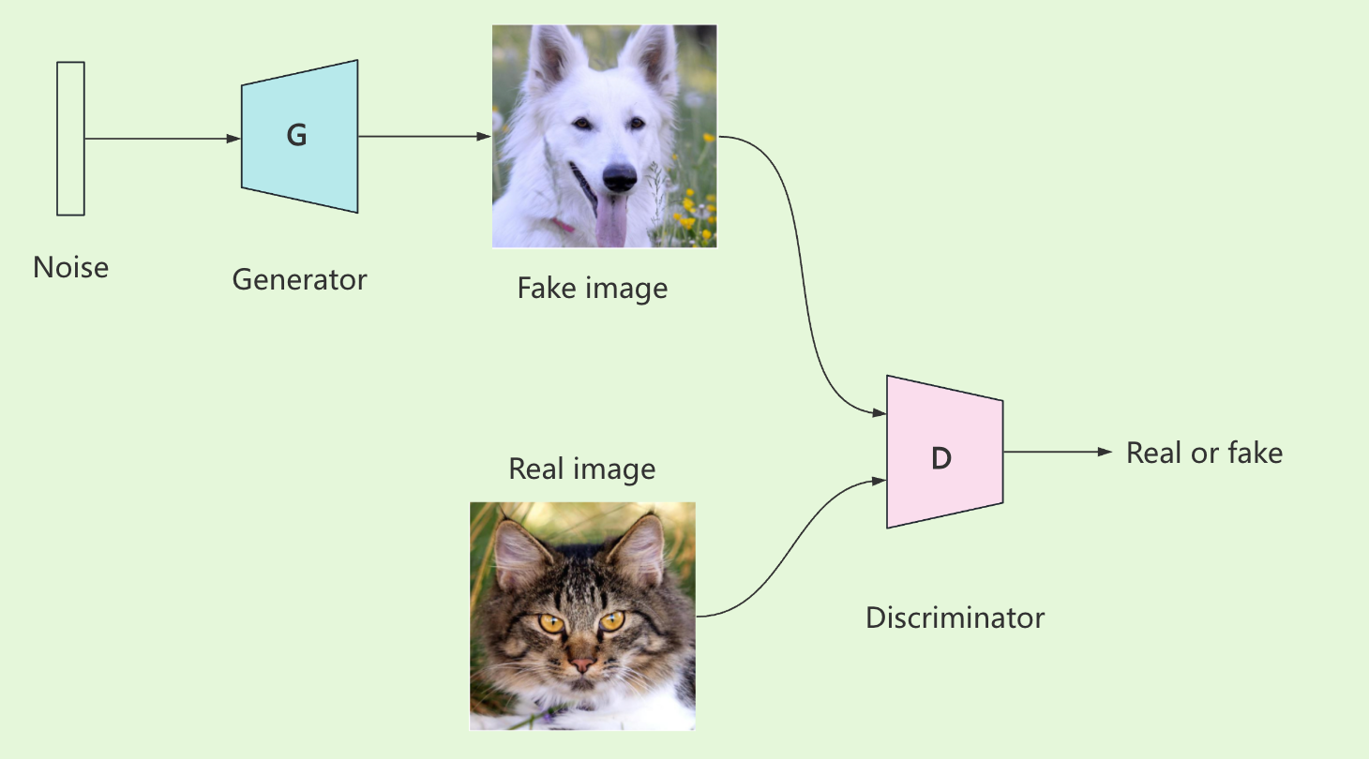
Background of GAN
01
Introduced by Ian Goodfellow in 2014.
GANs consist of two networks:
• Generator: Produces fake data.
• Discriminator: Differentiates between real and fake data.
GANs have made significant advancements in:
• Materials science.
• Medical imaging (e.g., improving lesion classification).
•Computer vision (e.g., style transfer, image generation).

Slide 5
Challenges
02
• Mode Collapse: The generator produces a limited variety of data.
• Training Instability: Difficulty in maintaining balance between generator and discriminator.
• High Computational Resources: GANs require extensive hardware for effective training.
• To investigate how different architectural choices and training strategies affect GAN performance.
• Focus on generating high-quality images using the AFHQ dataset with 16,130 high-resolution images to generate realistic cat images.

Slide 6
03
Goal
• To investigate how different architectural choices and training strategies affect GAN performance.
• Focus on generating high-quality images using the AFHQ dataset with 16,130 high-resolution images to generate realistic cat images.

Slide 7
University College Cork
2 Historical
Models
Kai

Slide 8
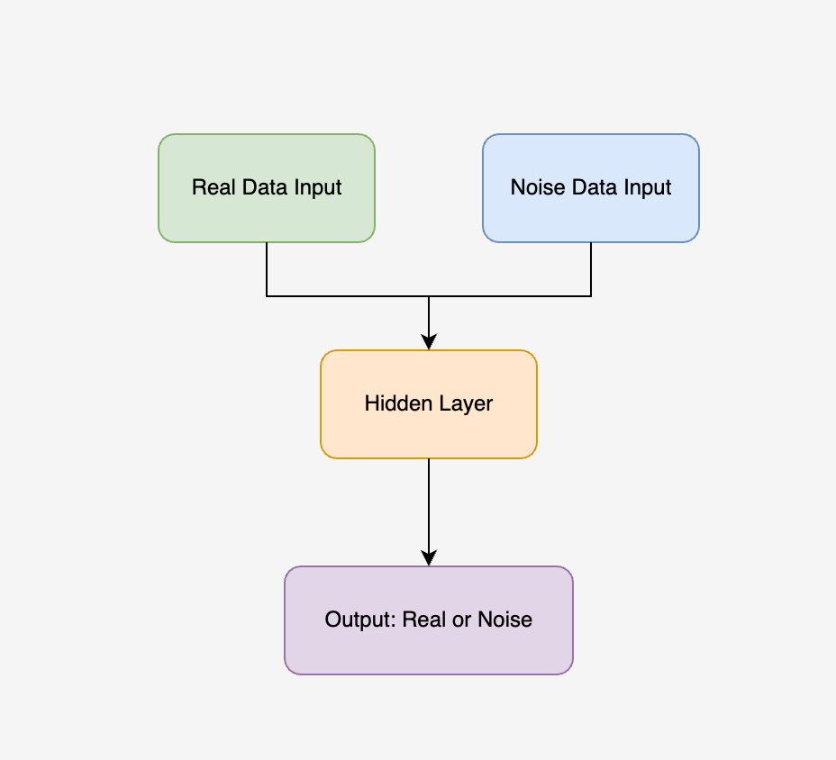
11
Noise Contrastive Estimation
What is NCE?:
Introduced in 2010 by Gutmann and Hyvärinen is a statistical method that simplifies learning by contrasting real data with noise.
Architecture:
• Two data inputs: Real data and noise samples.
• The model classifies between real and noisy data using binary classification.
Applications:
Widely used in density estimation and language modelling, laying the groundwork for image and text generation.

Slide 9
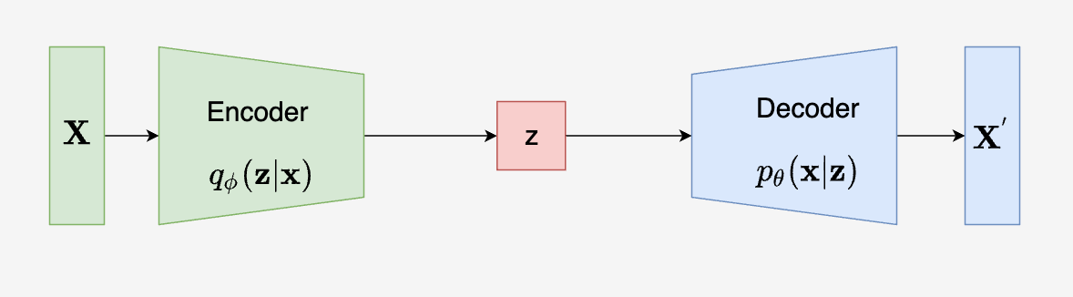
11
Variational Autoencoder
What is VAE?:
Introduced in 2013 by Kingma and Welling, VAE is a generative model that encodes input data into a latent space and reconstructs it by minimizing the reconstruction loss.
Architecture:
• Encoder: Compresses the input data into a smaller form (latent space).
• Decoder: Rebuilds the data from the compressed form.
Applications:
VAEs are used for image generation, data compression, and anomaly detection.

Slide 10
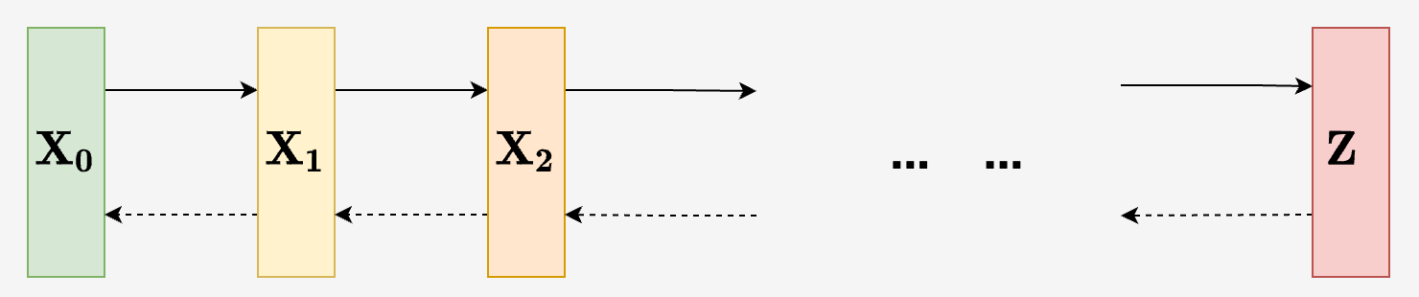
Diffusion Model
11
What is Diffusion Model?:
Introduced in 2020 by Ho et al., these models progressively add noise to the data and learn to reverse this process to generate high-quality outputs.
Architecture:
• Forward Process: Gradually adds Gaussian noise to the data.
• Reverse Process: Reverse the noise addition to reconstruct the original data.
Applications:
Diffusion models are used in image generation, audio synthesis, and medical imaging.

Slide 11
University College Cork
3 Theoretical Background
Kai

Slide 12
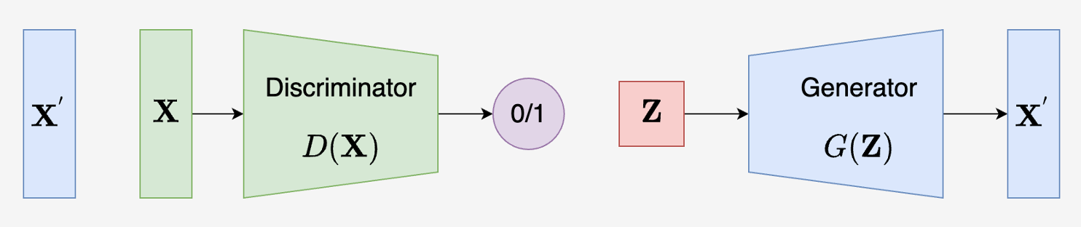
Generative Adversarial Network
11
What is GAN?:
GAN (Generative Adversarial Network) was introduced by Ian Goodfellow in 2014. It consists of two networks—a generator and a discriminator—that compete to improve data generation quality.
Architecture:
• Generator: Creates synthetic data to mimic real data.
• Discriminator: Distinguishes between real and generated data.
Applications:
Widely used in image generation, video synthesis, and style transfer for its ability to produce realistic data.

Slide 13
11
Objective Function of GAN
Objective Function:
• GANs use a minimax game between the generator and the discriminator.
• The generator tries to minimize the difference between real and generated data, while the discriminator tries to maximize it.
Generator’s Goal:
Minimize the probability that the discriminator correctly identifies fake data.
Discriminator’s Goal:
Maximize the probability of correctly distinguishing between real and fake data.

Slide 14
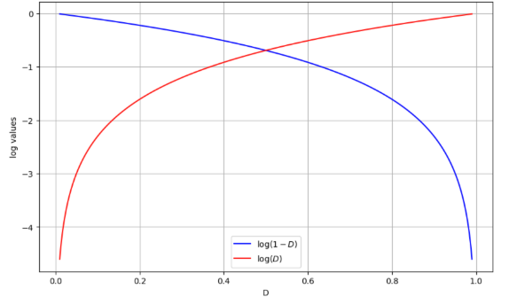
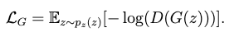
11
Loss Function of GAN
Discriminator’s Loss:
Measures how well the discriminator classifies real and fake data.
Loss function:
Generator’s Loss:
Measures how well the generator fools the discriminator.
Loss function:

Slide 15
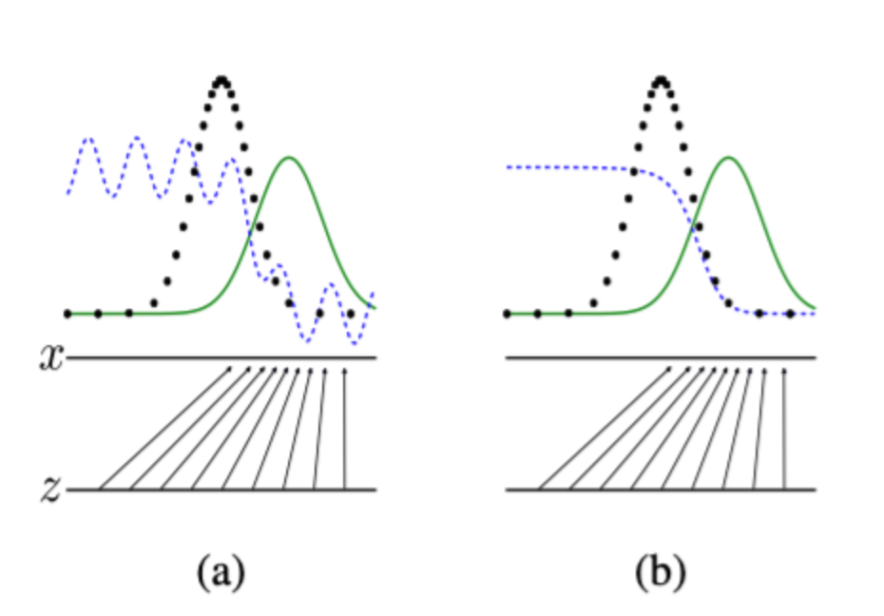
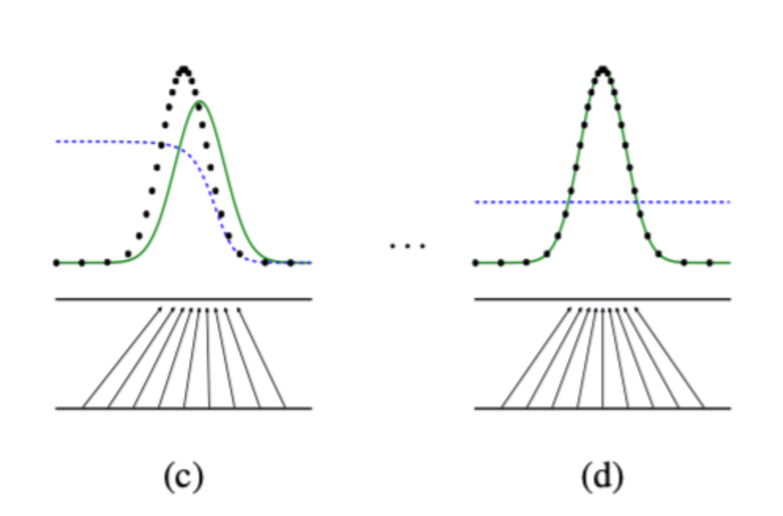
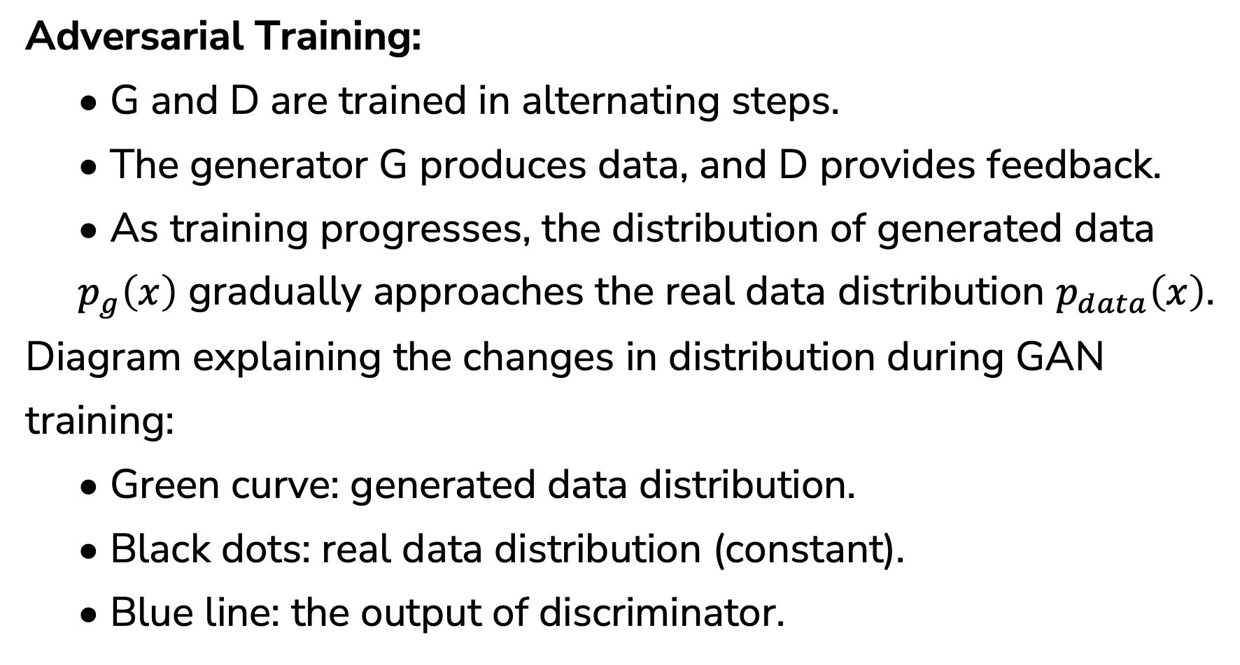
11
Training Process of GAN
Adversarial Training:
• G and D are trained in alternating steps.
• The generator G produces data, and D provides feedback.
• As training progresses, the distribution of generated data $p_{g}\left(x\right)$ gradually approaches the real data distribution $p_{data}\left(x\right)$.
Diagram explaining the changes in distribution during GAN training:
• Green curve: generated data distribution.
• Black dots: real data distribution (constant).
• Blue line: the output of discriminator.

Slide 16
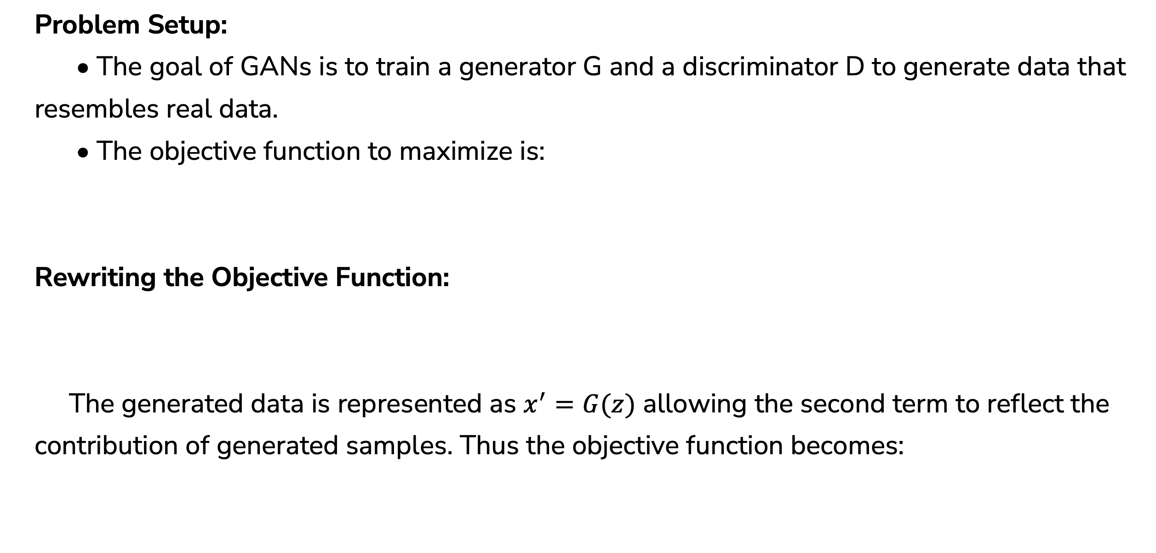
11
Training Process of GAN
Problem Setup:
• The goal of GANs is to train a generator G and a discriminator D to generate data that resembles real data.
• The objective function to maximize is:
Rewriting the Objective Function:
The generated data is represented as $x^{′}=G(z)$ allowing the second term to reflect the contribution of generated samples. Thus the objective function becomes:

Slide 17
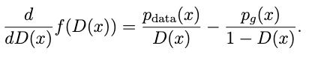
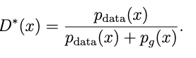
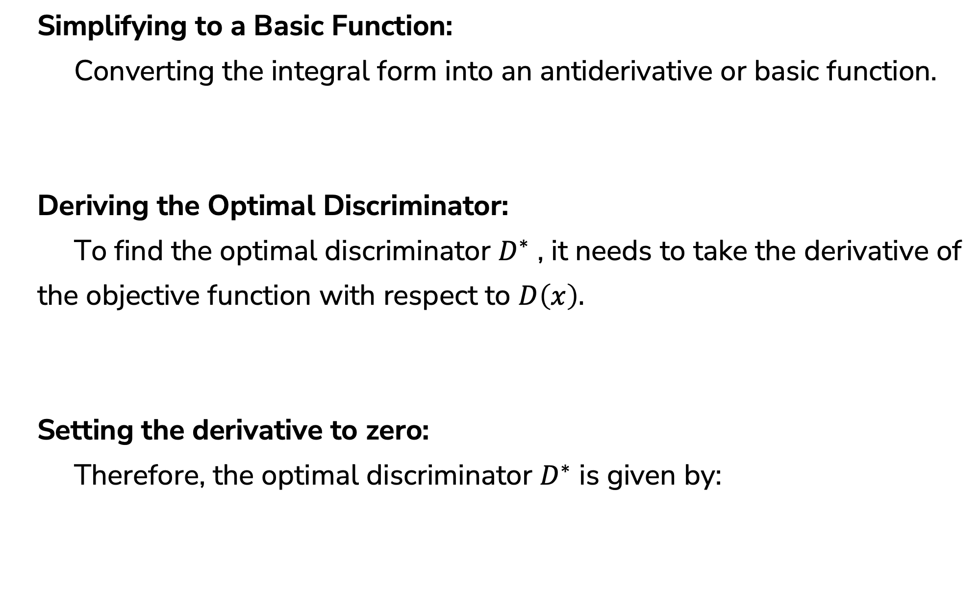
11
Training Process of GAN
Simplifying to a Basic Function:
Converting the integral form into an antiderivative or basic function.
Deriving the Optimal Discriminator:
To find the optimal discriminator $D^{∗}$ , it needs to take the derivative of
the objective function with respect to $D\left(x\right).$
Setting the derivative to zero:
Therefore, the optimal discriminator $D^{∗}$ is given by:

Slide 18
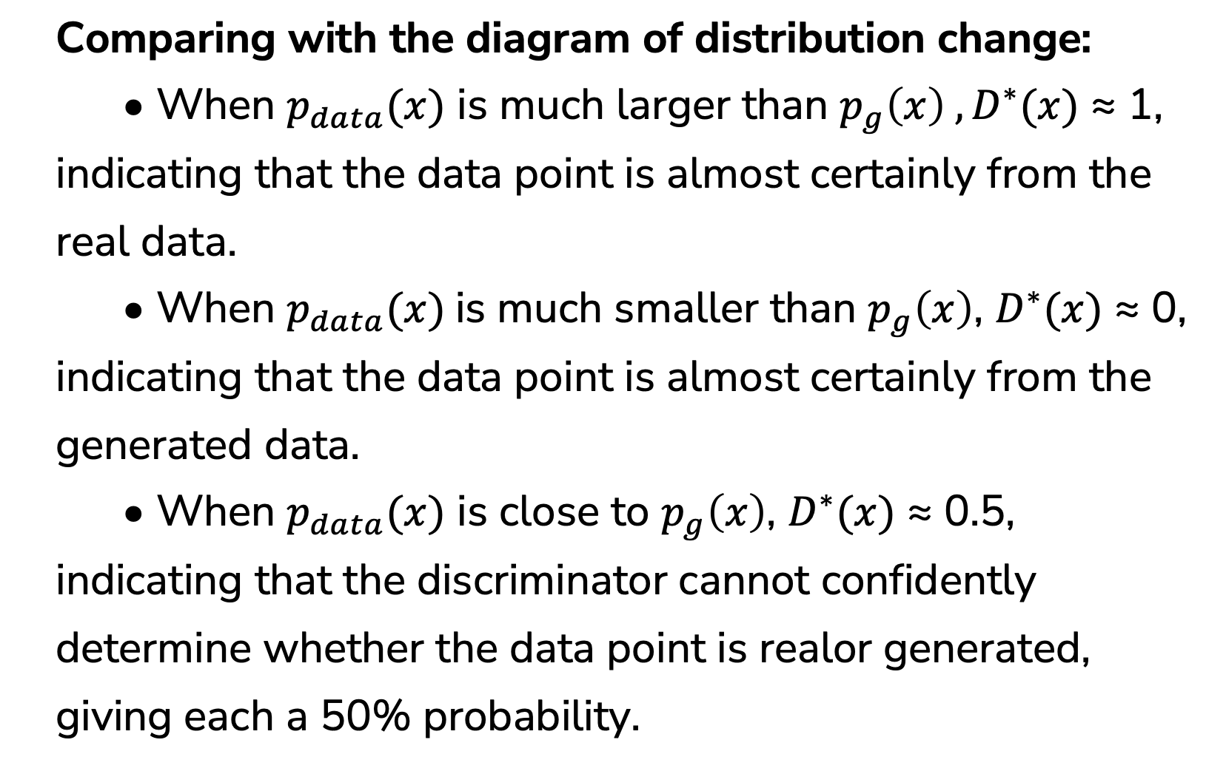
Verifying the Optimal Discriminator
11
Comparing with the diagram of distribution change:
• When $p_{data}(x)$ is much larger than $p_{g}\left(x\right) ,D^{∗}(x)$ ≈ 1, indicating that the data point is almost certainly from the real data.
• When $p_{data}(x)$is much smaller than $p_{g}\left(x\right)$, $D^{∗}(x)$ ≈ 0, indicating that the data point is almost certainly from the generated data.
• When $p_{data}(x)$ is close to $p_{g}\left(x\right)$, $D^{∗}(x)$ ≈ 0.5, indicating that the discriminator cannot confidently determine whether the data point is realor generated, giving each a 50% probability.

Slide 19
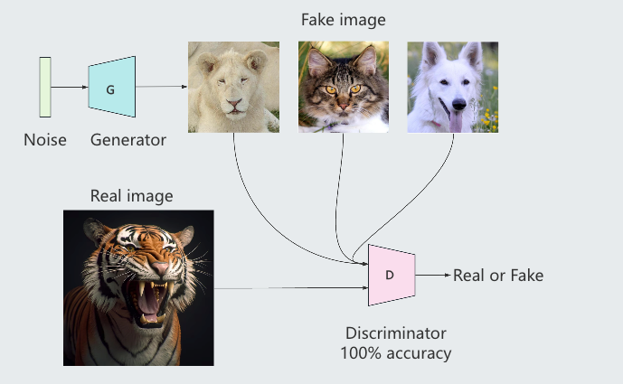
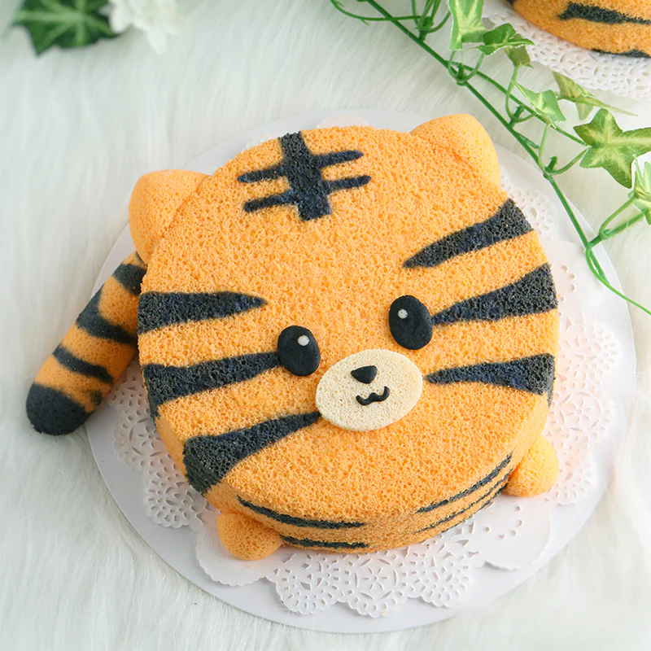
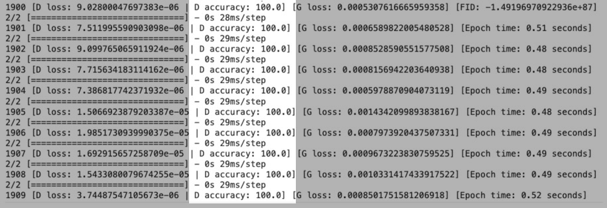
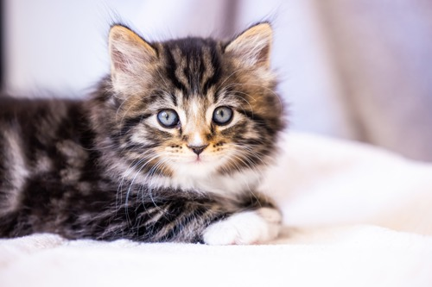
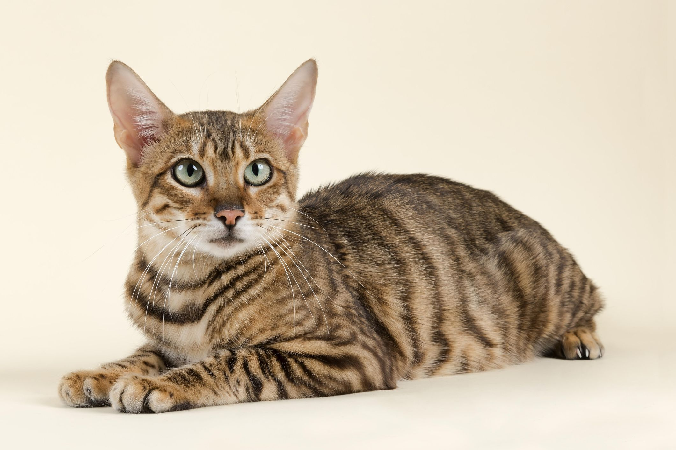
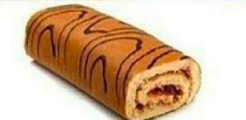
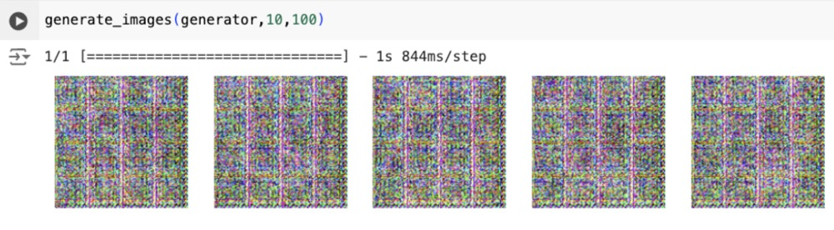
11
Evaluating GAN Performance
• In most machine learning models, accuracy is a key evaluation metric. However, in the case of GAN training, achieving 100% accuracy indicates a problem. It means that the balance between the generator and the discriminator is broken.

Slide 20
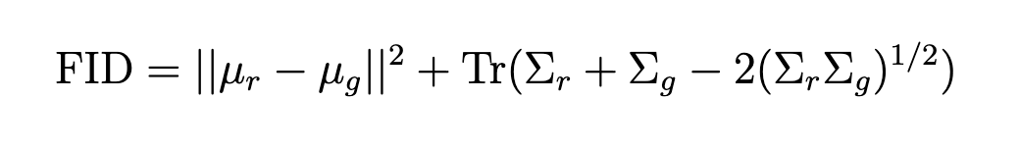
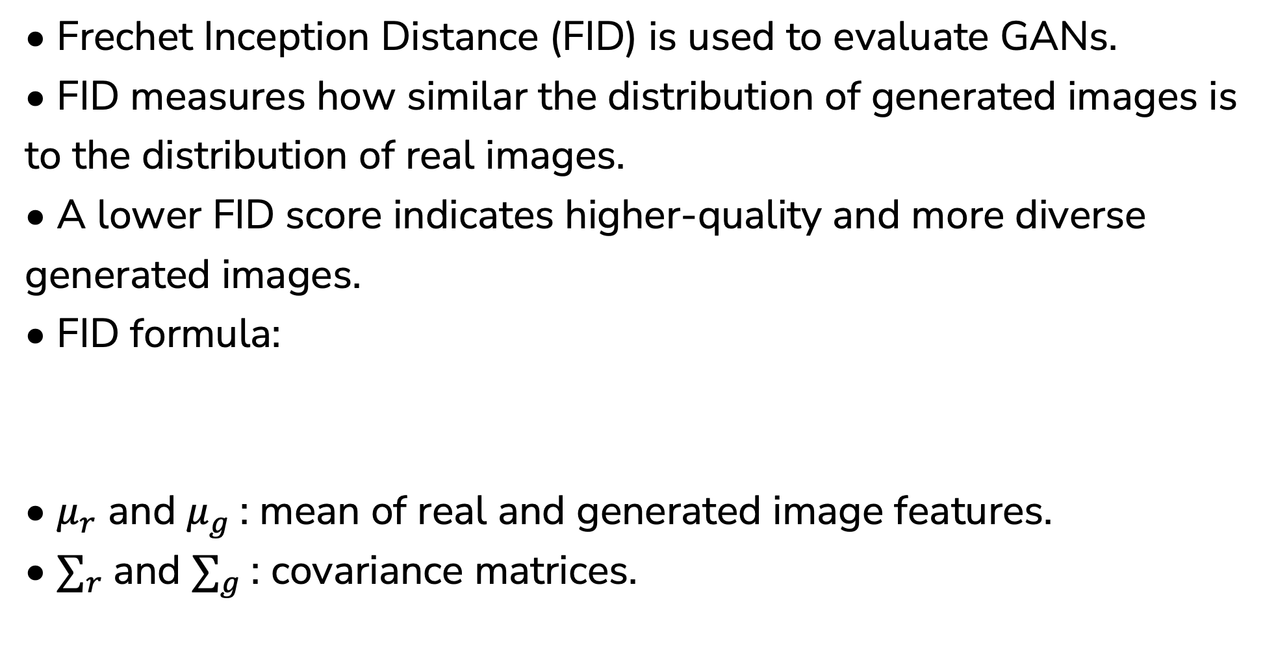
11
Frechet Inception Distance
• Frechet Inception Distance (FID) is used to evaluate GANs.
• FID measures how similar the distribution of generated images is to the distribution of real images.
• A lower FID score indicates higher-quality and more diverse generated images.
• FID formula:
• $μ_{r}$ and $μ_{g}$: mean of real and generated image features.
• $∑_{r}$and $∑_{g}$: covariance matrices.

Slide 21
University College Cork
4 Results
Kai

Slide 22
11
Model Select
Reason for Choosing Standard GAN:
• Foundational Model: Standard GAN serves as the base for all other GAN variants.
• Well-Documented: Extensive literature available for comparison and reference.
• Training Efficiency: More computationally feasible to implement within hardware constraints.
• Flexibility: Can be adapted to various image generation tasks, providing a solid baseline for comparison with more complex models.

Slide 23
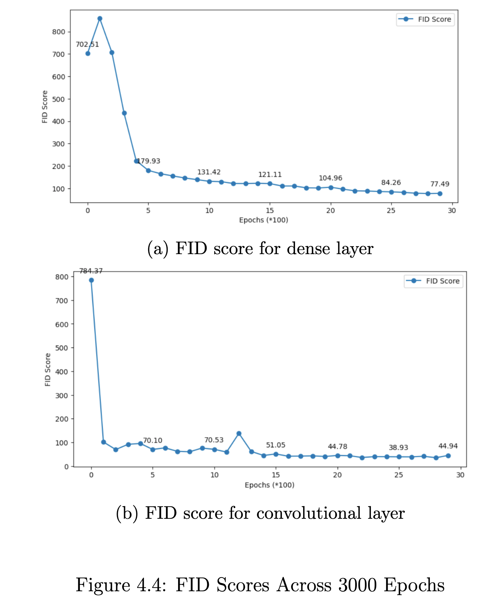
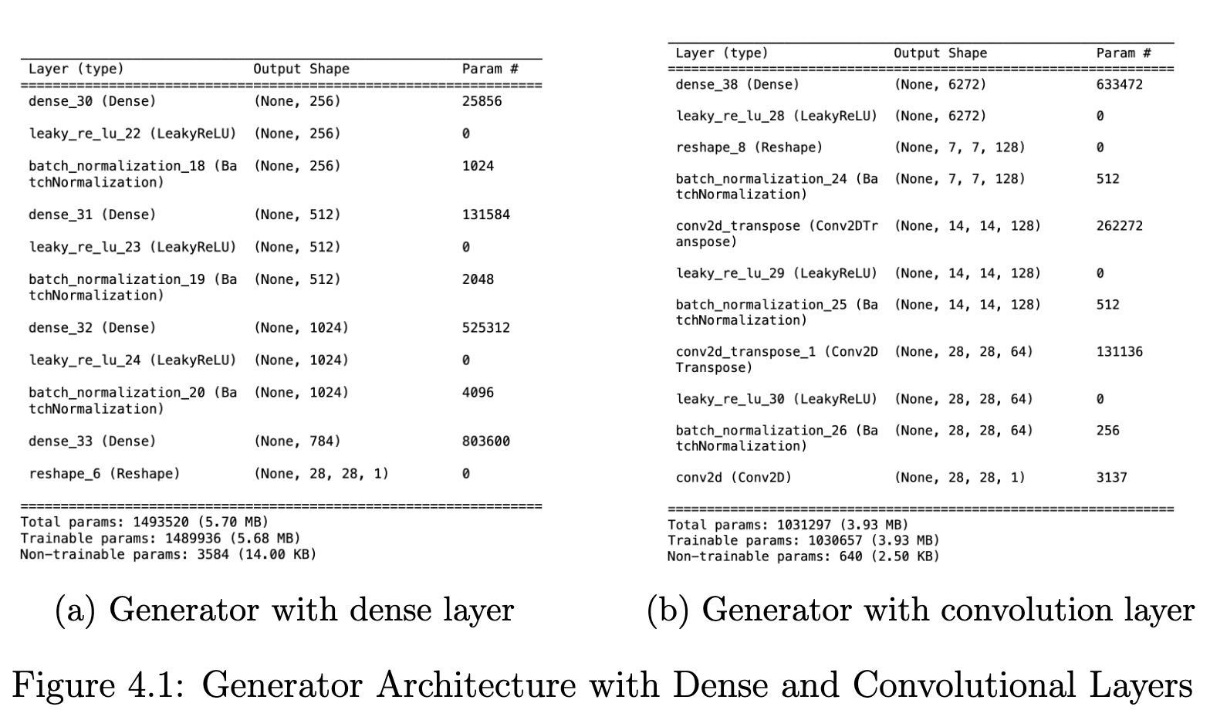
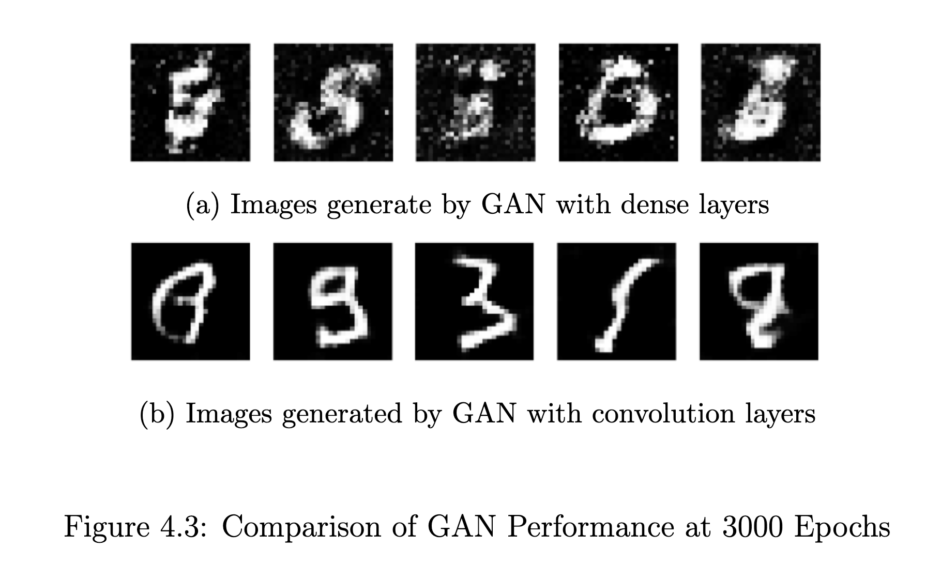
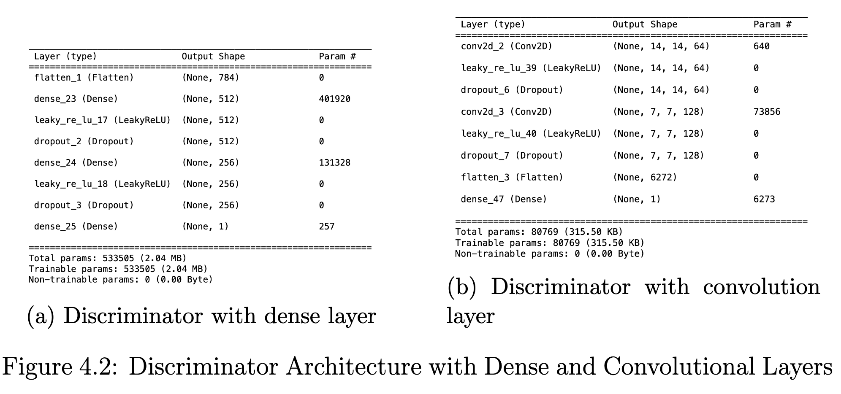
11
Convolutional or Dense
Objective:
• Compare the performance of Convolutional Layers and Dense Layers in the generator and discriminator of a standard GAN.
Key Factors Tested:
• Image quality.
• FID score.
• Training time.
Dataset:
• MNIST Dataset (3000 epochs).

Slide 24
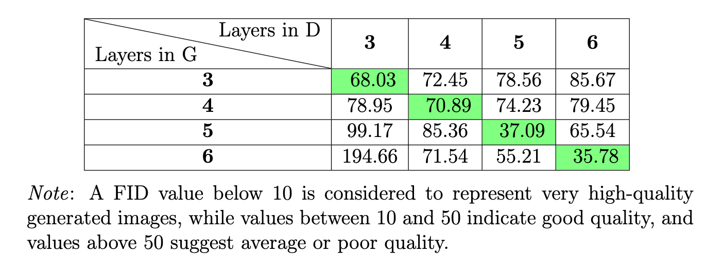
11
Exploring Layer Depth
Key Objective:
• Investigate the impact of increasing convolutional layer depth on GAN performance.
Experiment Setup:
• Base Model: Standard GAN (with convolutional layers).
• Layer Variations: 3, 4, 5, and 6 layers in both generator and discriminator.
• Key Metric: Frechet Inception Distance (FID) to evaluate image quality.
Results:
• Increasing depth in only the generator or discriminator leads to worse performance.
• Increasing depth in both networks simultaneously results in better performance.

Slide 25
11
Impact of Data Augmentation
Objective:
• Evaluate the impact of data augmentation techniques in GAN.
Techniques Tested:
• Rotation: Rotating images by a 10 degree.
• Shifting: Vertical and horizontal shift 0.1.
• Flipping: horizontal flips.
Results:
Without Data Augmentation model performs best.
After Adjustments:
• Removing certain techniques (e.g., flipping, rotation).

Slide 26
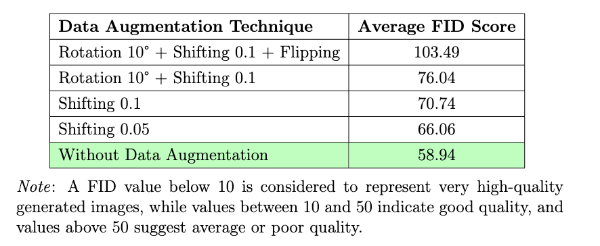
11
Impact of Data Augmentation
Results
Assumption:
Data augmentation introduced noise, disturbing the real data distribution.

Slide 27
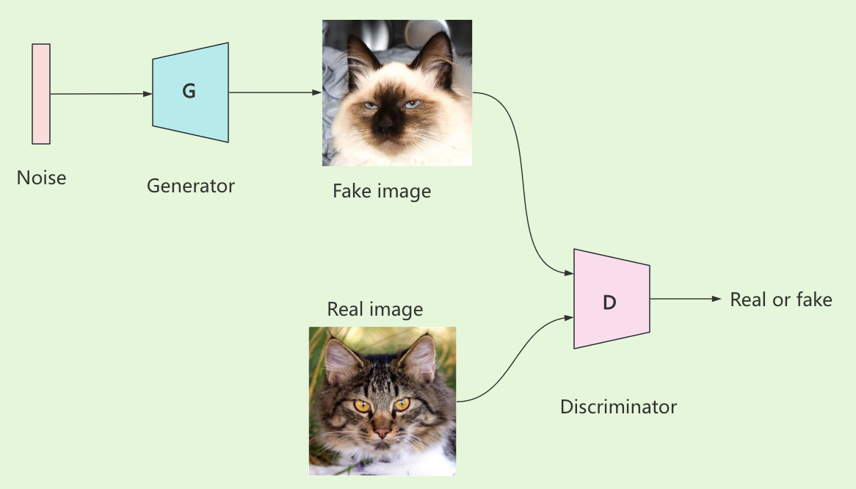
Applying Animal Faces HQ Dataset
11
Dataset Overview:
• Animal Faces-HQ (AFHQ) dataset contains 16,130 high-quality images of animal faces.
• Images are originally 512x512 pixels, downscaled to 128x128 pixels for memory efficiency during training.
Architecture:

Slide 28
Applying Animal Faces HQ Dataset
11
Model Structure:
• The generator takes a 100-dimensional noise vector, has 5 transpose convolutional layers with LeakyReLU activation and batch normalization, and outputs a 3×128×128 image.
• The discriminator takes a 3×128×128 image as input, has 5 convolutional layers with LeakyReLU activation, batch normalization, and dropout and outputs a single probability value indicating real or fake data.
Training Details:
• Optimizer: Adam.
• Learning rate: 0.0002.
• Epochs: 4000 epochs of training using this dataset.

Slide 29
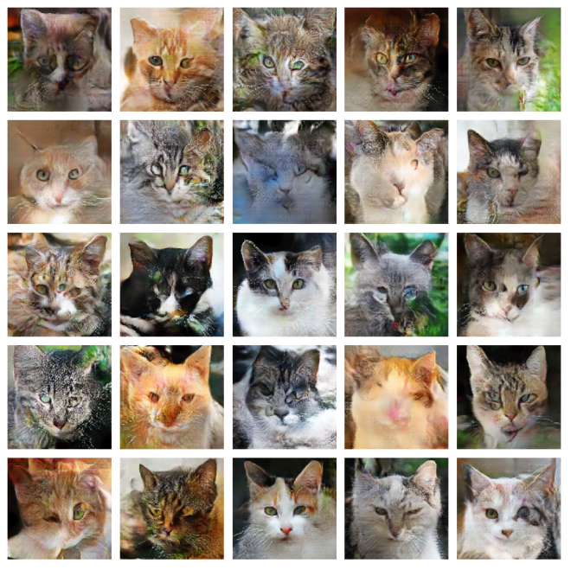
Generate Cat Faces
11

Slide 30
University College Cork
5 Discussion
Kai

Slide 31
Discussion
11
Dataset Overview:
• Animal Faces-HQ (AFHQ) dataset contains 16,130 high-quality images of animal faces.
• Images are originally 512x512 pixels, downscaled to 128x128 pixels for memory efficiency during training.
Architecture:

Slide 32
Future Work
11
Model Improvements:
• Adjust hyperparameters for better stability.
• Explore advanced architectures like StyleGAN.
• Dataset:
• Use larger and more diverse datasets for improved generalization.
• New Techniques:
• Experiment with adaptive data augmentation methods.

Slide 33


University College Cork
Thank You

